Slide 1
DIABETES PROJECT
Presentation by Abdallah shanaah

Slide 2
TABLE OF CONTENTS
1
INTRODUCTION
2
MAIN IDEA
3
LIBRARIES
4
Conclusions
DATA PREPROCESSING
5

Slide 3
INTRODUCTION
This project addresses the use of a dataset that is originally from the National Institute of Diabetes and Digestive and Kidney Diseases

Slide 4
MAIN IDEA
The main idea of the project is to predict whether a person suffers from
diabetes through his clinical diagnosis such as
insulin levels,
blood pressure,
glucose level,
age

Slide 5
LIBRARIES
Pandas
NumPy
Seaborn
Matplotlib
mlxtend
missingno
scikit-learn
keras
pre-processed
Plots and figure
Build machine learning

Slide 6
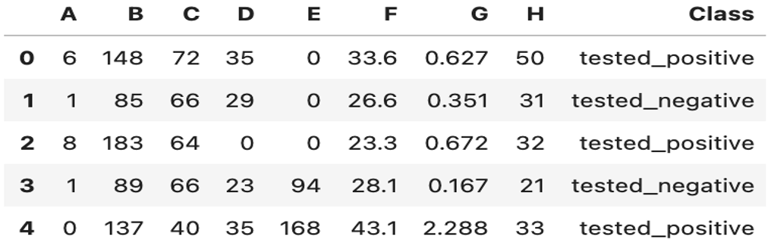
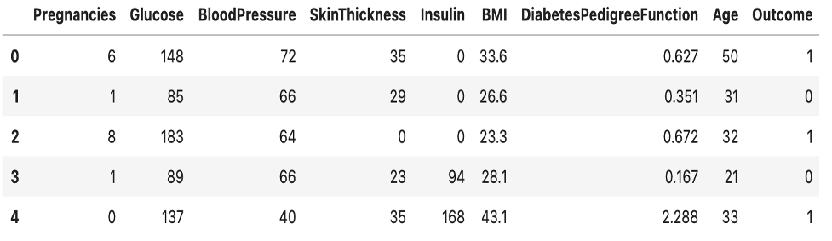
DATA PREPROCESSING

Slide 7
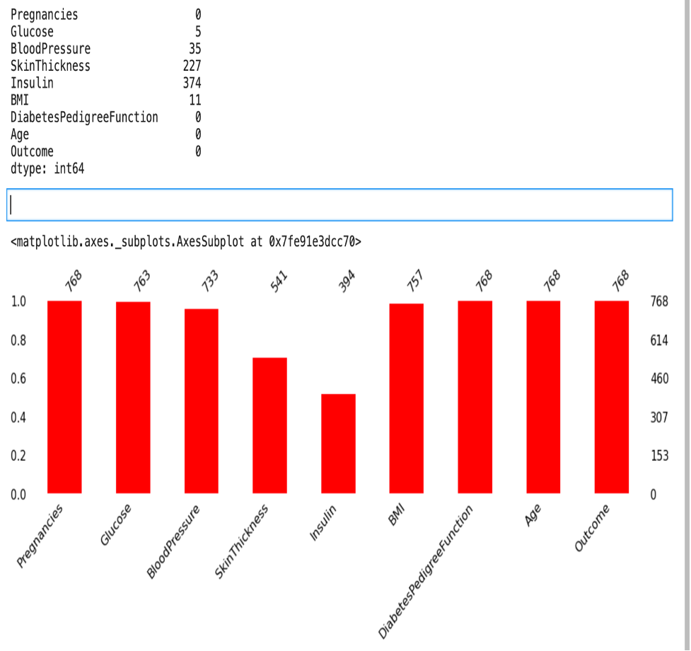
DATA PREPROCESSING

Slide 8
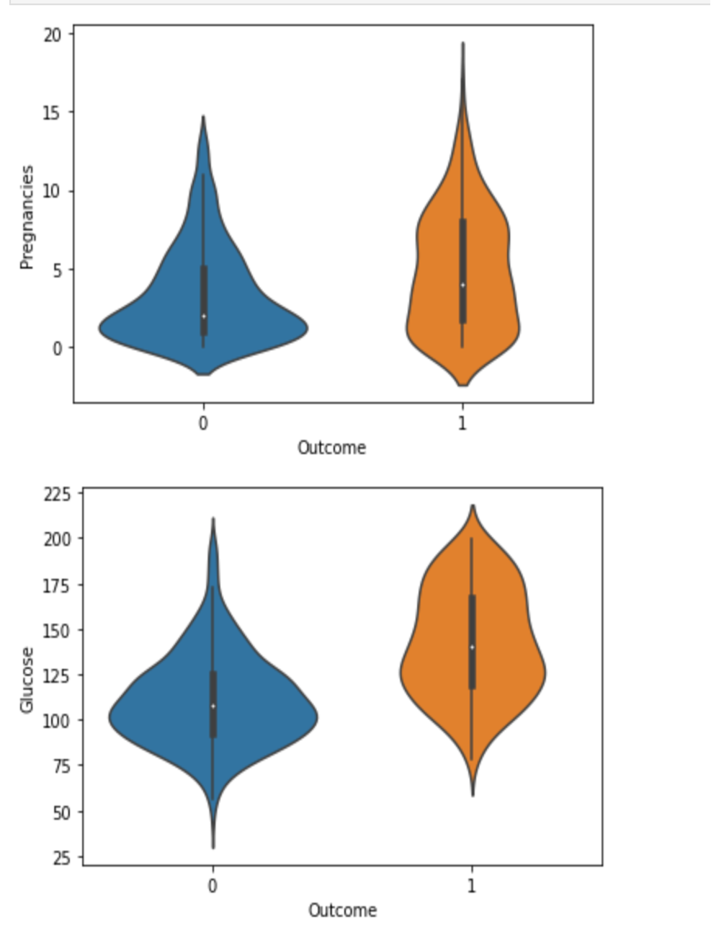
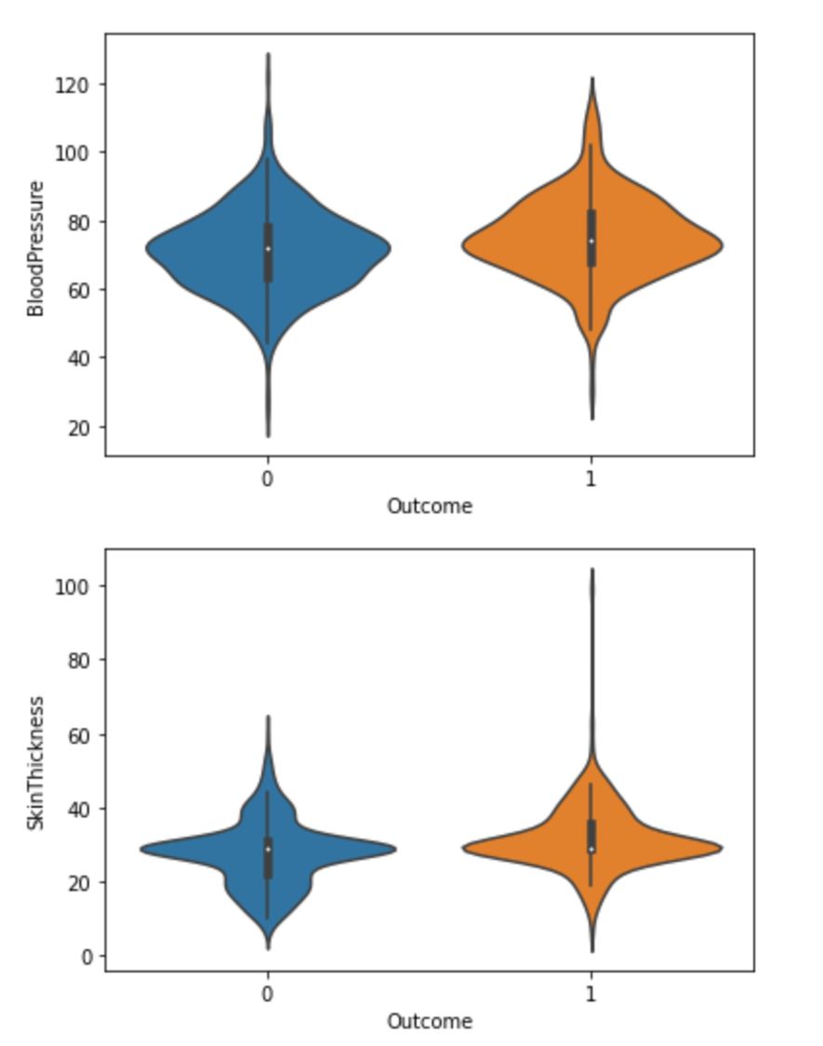
FACTORS TO CONSIDER

Slide 9
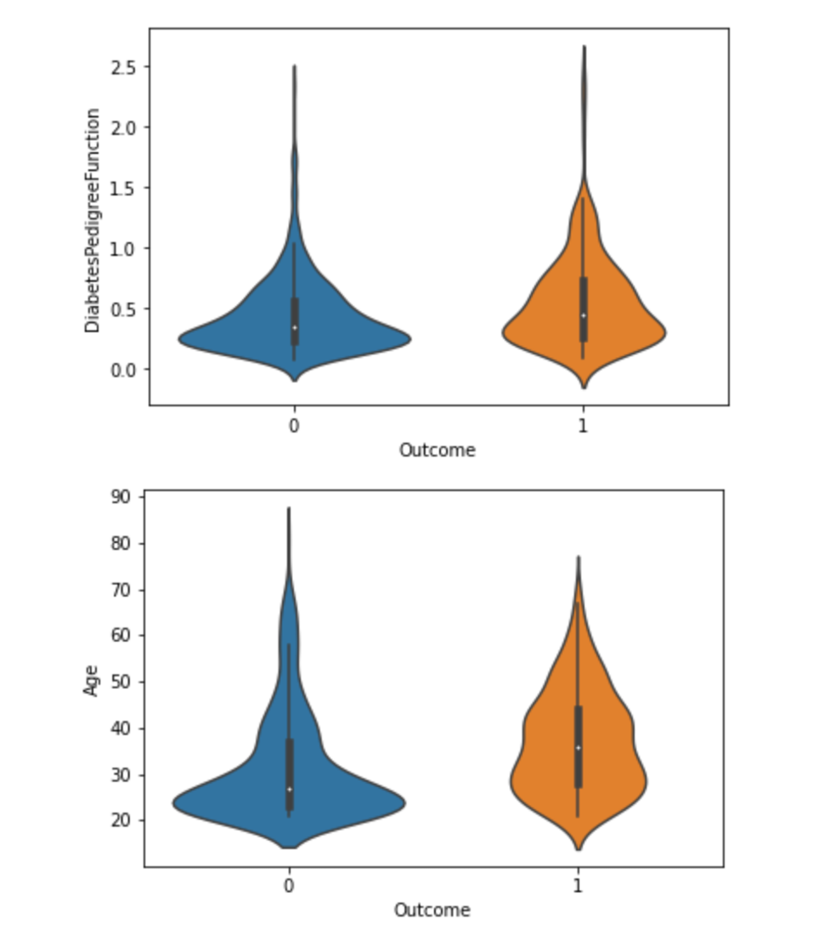
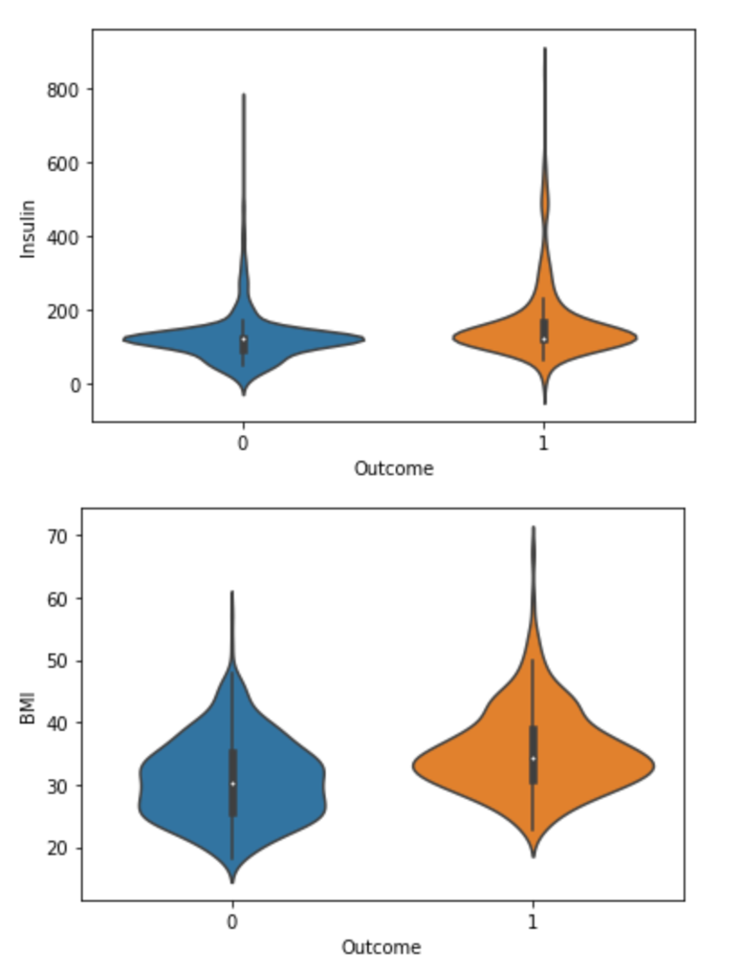
DATA PREPROCESSING

Slide 10
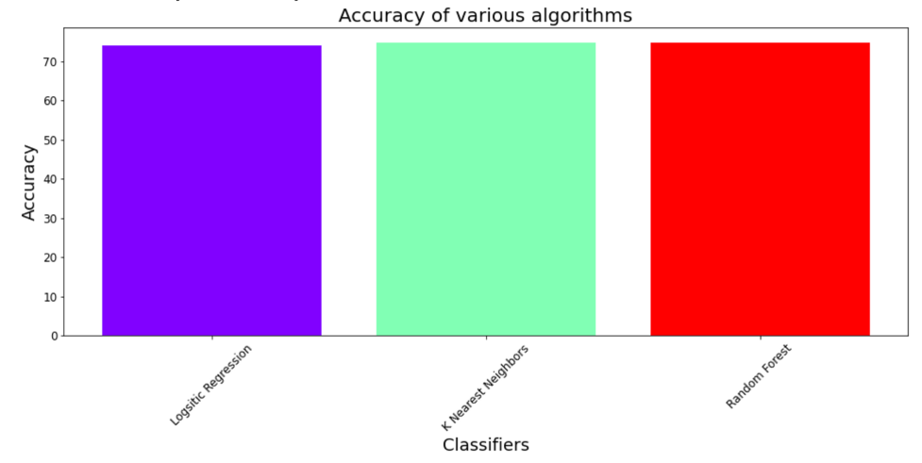
Conclusion
After building more then one classifier such as Logistic Regression, K-Nearest Neighbors and Random Forest, do some comparison between them to find the best classifier I reached that K-Nearest Neighbors is the best classifier with accuracy at the level of 74.8% was achieved.

